Slide 1

KLS Gogte Institute Of Technology, Belagavi
Seminar on Project Phase 2
Presented by:
Pavan Chikkodikar 2GI19CS089
Laxmikant Pujeri 2GI19CS063
Narasimha Katti 2GI19CS079
Niranjan Baloji 2GI19CS083
Guided By : Prof. Sagar Pujar

Slide 2
Problem Statement
Crop Suitability and Weather Forecast Recommendation System Using Machine Learning Approach

Slide 3
Abstract
This paper proposes a viable and user-friendly yield prediction system for the farmers. The proposed system provides connectivity to farmers via a web application.
The user provides the area & soil type as input. Machine learning algorithms allow choosing the most profitable crop list or predicting the crop yield for a user-selected crop.
To predict the crop yield, selected Machine Learning algorithms such as Support Vector Machine (SVM), Artificial Neural Network (ANN), Random Forest (RF), Multivariate Linear Regression (MLR), and K-Nearest Neighbour (KNN) are used.
Among them, the Random Forest showed the best results with 95% accuracy. Additionally, the system also suggests the best time to use the fertilizers to boost up the yield.

Slide 4
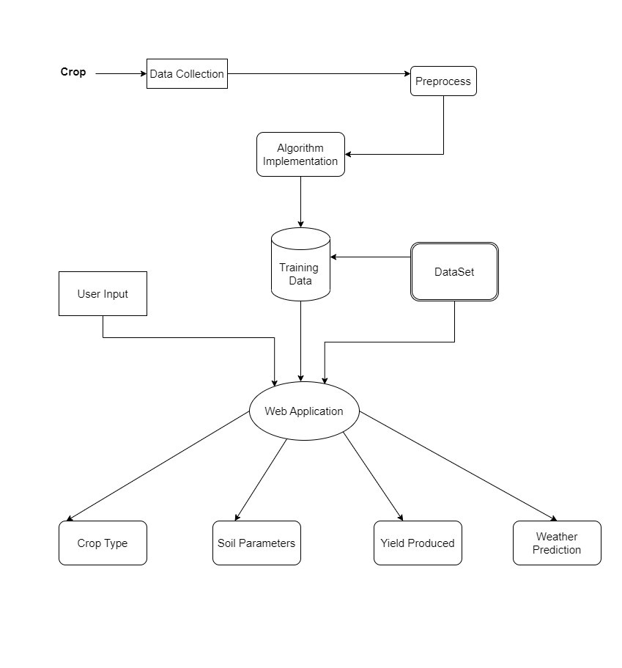
Flow Diagram:

Slide 5
Advantages of Proposed System:
The proposed model predicts the crop yield for the data sets of the given region. Integrating agriculture and ML will contribute to more enhancements in the agriculture sector by increasing the yields and optimizing the resources involved. The data from previous years are the key elements in forecasting current performance.
The proposed system uses recommender system to suggest the right time for using fertilizers.
The methods in the proposed system includes increasing the yield of crops, real-time analysis of crops, selecting efficient parameters, making smarter decisions and getting better yield.

Slide 6
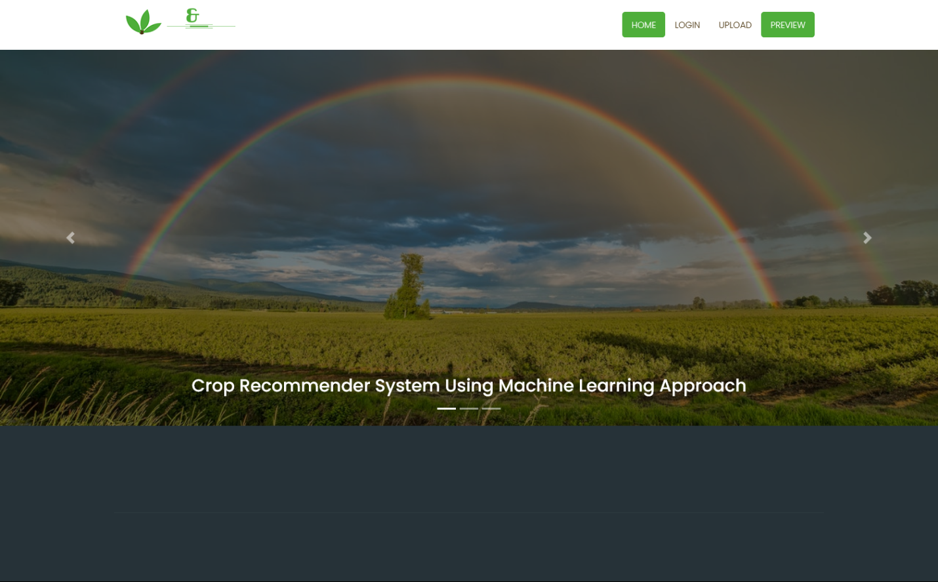
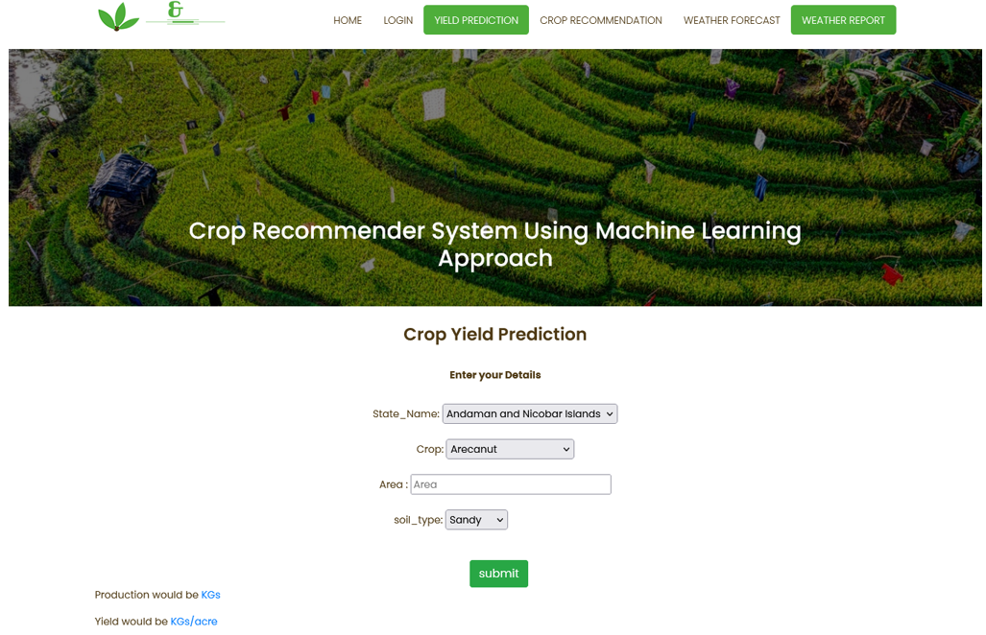
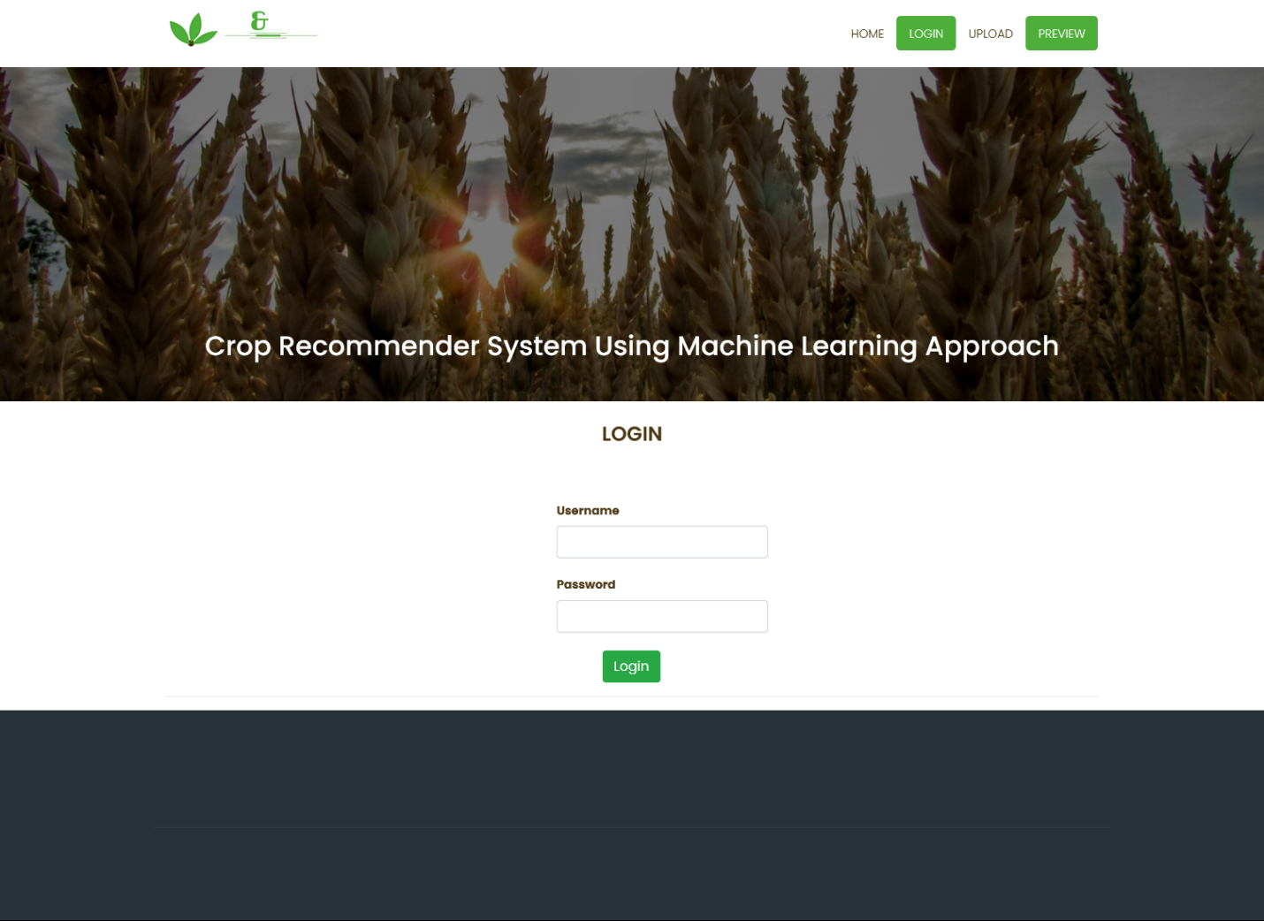
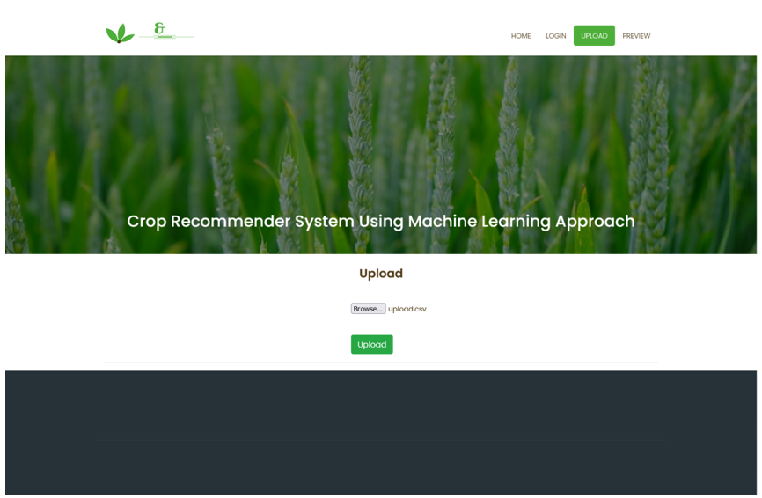

Slide 7
Conclusion:
As our farmers presently are not using technology in their farming practices, they are lagging behind in their farming approaches. Hence, we have made this project so as to encourage farmers to use the current technology instead of relying on old methods. Growing a crop requires a lot of knowledge and insight into many things such as the contents of soil, temperature, pH of soil etc. and hence it would make sense for the farmer to adopt to newer technologies as it would make his life easier. Using machine learning algorithms, we predicted an accuracy of 98% of predicting the right crop to grow and if the farmer adopts to this technology which would not only make his life easier but also help him in making decisions that do not exploit the environment.

Slide 8
References:
SHILPA MANGESH PANDE, DR. PREM KUMAR RAMESH, ANMOL, B.R AISHWARYA, KARUNA ROHILLA, KUMAR SHAURYA, “Crop Recommender System Using Machine Learning Approach”, IEEE Conference 2021.
Archana Chougule, Vijay Kumar Jha and Debajyoti Mukhopadhyay “Crop Suitability and Fertilizers Recommendation using Data Mining Techniques” Springer Nature Singapore Pte Ltd. 2019

Slide 9
Thank You

